Slide 1


Fundamentals of RM
RM System and Process
Leadership in RM
Incident Investigation
RM Tools & Challenges
RM in Industry
People & Org.
Application and Perspectives
On Becoming a
Leader in Risk Management
ENGG404 - Lecture
Chapter 4.2: Cause and Effect Model for Incident Analysis
Chapter 4.3: Root Cause Analysis of an Incident
- Latent Causes -

Slide 2
Learning Outcomes:
This topic:
Builds on Topic #18 Chapter 4.2: Cause and Effect Model for Incident Analysis and Chapter 4.3: Root Cause Analysis of an Incident - Fundamentals
Examines the latent causes as discovered in a Root Cause Analysis;
Learning Outcomes:
Develop a thorough, comprehensive, and logical RCA Chart.
Explain the parts of and write an acceptable statement of a latent cause in an RCA.
Link a latent cause to a management system element.
Set the stage with a well-written, acceptable latent cause statement in order to create a recommendation to address that latent cause.
Chapter 4.2: C&E Model & Chapter 4.3: RCA of an Incident
‹#›
Notes:
‹#›

Slide 3
Latent Causes – The What and Why:
Latent causes are weaknesses (or failures) in the elements of the Risk Management System.
They are NOT:
Risk Management System Elements
Management failures i.e. “management failed to …”
See “Factors often missed or completed incorrectly for the RCA chart” in the Team Project Instruction Manual
When identified, the latent causes:
Relate to the elements of the management system
Reflect inadequacies in the management system and program
Are stated in unique terms specific to the root in the RCA for that loss incident.
Thus, meaningful management action and management control can be undertaken to address a latent cause.
Leaders must drive the root cause analysis process to effectively find the Latent Causes.
Chapter 4.2: C&E Model & Chapter 4.3: RCA of an Incident
‹#›
Notes:
‹#›

Slide 4
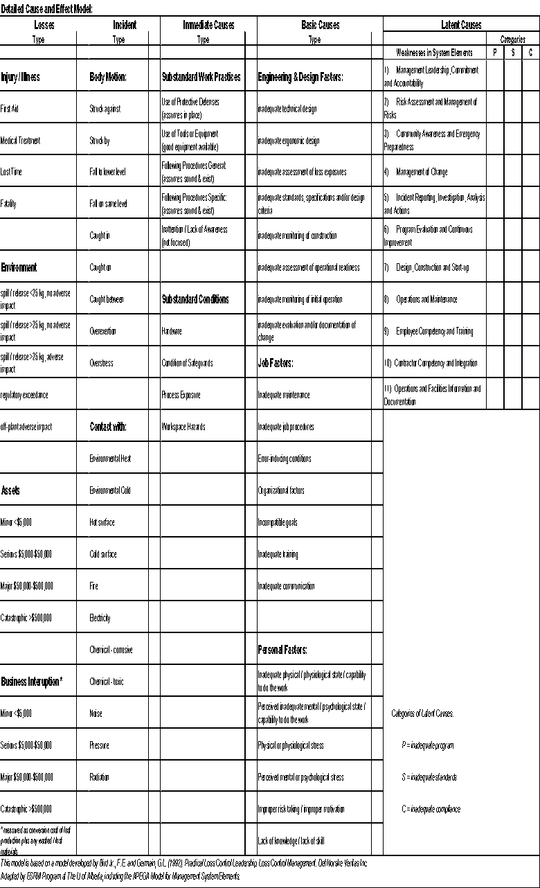
Practice – Latent Causes:
Let’s redraw the RCA and focus on three basic causes to discover the root causes on the RCA!
Mining LI: “You are called to a scene where a mining haul truck and a shovel have been crushed with debris from an adjacent slope. You find one individual with a severe injury. You know the slopes are being monitored, you know there are procedures for safe work near the slopes, you know it had been raining for the last week.”
Chapter 4.2: C&E Model & Chapter 4.3: RCA of an Incident
‹#›
Notes:
‹#›
This is meant to drive class discussion

Slide 5
Drilling Down to Latent Causes in the RCA:
Debris fell on equipment, injuring one Worker & damaged equipment
Let’s redraw the RCA and focus on three basic causes to discover the root causes on the RCA!
Equipment & Worker Were In Exclusion Zone
Worker did not follow exclusion zone procedures
Worker was not aware of exclusion zone procedures
Worker disregarded exclusion zone procedures
Supervisor told Worker to go into the exclusion zone
Chapter 4.2: C&E Model & Chapter 4.3: RCA of an Incident
‹#›
Notes:
‹#›

Slide 6
Drilling Down to Latent Causes in the RCA:
Debris fell on equipment, injuring one Worker & damaged equipment
Equipment & Worker Were In Exclusion Zone
Worker did not follow exclusion zone procedures
Basic Cause?
Does this
make sense?
Is there a
logic leap?
Worker was not aware of exclusion zone procedures
Worker disregarded exclusion zone procedures
Supervisor told Worker to go into the exclusion zone
LC1: There was no training program for mining operations.
Chapter 4.2: C&E Model & Chapter 4.3: RCA of an Incident
‹#›
Notes:
‹#›

Slide 7
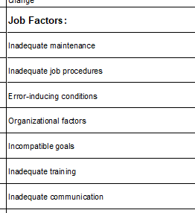
Drilling Down to Latent Causes in the RCA:
Debris fell on equipment, injuring one Worker & damaged equipment
Equipment & Worker Were In Exclusion Zone
Worker did not follow exclusion zone procedures
Basic Cause
Worker was not aware of exclusion zone procedures
Worker disregarded exclusion zone procedures
Supervisor told Worker to go into the exclusion zone
Intermediate Basic Cause
Use the C&E Model to determine cause-category:
Worker was not trained on those procedures
Latent Cause
LC1: There was no training program for mining operations.
BC sub-sub-category
Chapter 4.2: C&E Model & Chapter 4.3: RCA of an Incident
‹#›
Notes:
‹#›

Slide 8
Drilling Down to Latent Causes in the RCA:
Worker did not follow exclusion zone procedures
Intermediate Immediate Cause
Worker was not aware of exclusion zone procedures
Worker disregarded exclusion zone procedures
Supervisor told Worker to go into the exclusion zone
Basic Cause
B-JF: Procedures were not enforced through audits
LC2: The auditing program schedule did not include the exclusion zone procedures
Latent Cause
Chapter 4.2: C&E Model & Chapter 4.3: RCA of an Incident
‹#›
Notes:
‹#›

Slide 9
Drilling Down to Latent Causes in the RCA:
Worker did not follow exclusion zone procedures
Worker was not aware of exclusion zone procedures
Basic Cause
Worker disregarded exclusion zone procedures
Is this an acceptable statement
for a latent cause?
Supervisor told Worker to go into the exclusion zone
Int. Basic Cause
Basic Cause
B-JF: Supervisor prioritized production over safety
Latent Cause?
Supervisor believed that production was paramount over safety
Chapter 4.2: C&E Model & Chapter 4.3: RCA of an Incident
‹#›
Notes:
‹#›

Slide 10
Drilling Down to Latent Causes in the RCA:
Worker did not follow exclusion zone procedures
Worker was not aware of exclusion zone procedures
Basic Cause
Worker disregarded exclusion zone procedures
Does this
make sense?
Supervisor told Worker to go into the exclusion zone
Intermediate Basic Cause
Basic Cause
B-JF: Supervisor prioritized production over safety
Intermediate
Supervisor believed that production was paramount over safety
Latent Cause
LC3: Core Safety Values Communications Program was inadequate **
Chapter 4.2: C&E Model & Chapter 4.3: RCA of an Incident
‹#›
Notes:
‹#›

Slide 11
Drilling Down to Latent Causes in the RCA:
Worker did not follow exclusion zone procedures
Worker was not aware of exclusion zone procedures
Basic Cause
Worker disregarded exclusion zone procedures
Supervisor told Worker to go into the exclusion zone
Int. Basic Cause
B-JF: Supervisor prioritized production over safety
Intermediate
Supervisor believed that production was paramount over safety
Intermediate
Sr Mngmt expectations were not in alignment with core safety values
Latent Cause
LC3: Core Safety Values Communications Program was inadequate **
** Is this an acceptable latent cause statement? We will revisit this!
Chapter 4.2: C&E Model & Chapter 4.3: RCA of an Incident
‹#›
Notes:
‹#›

Slide 12
Basic Causes
Debris fell, injuring one Worker & damaged equipment
IC-SC: Equipment & Worker Were In Exclusion Zone
The RCA Chart
is developed!
Latent Causes
IC-SP: Worker did not follow exclusion zone procedures
BC-PF: Worker was not aware of exclusion zone procedures
IC-SP: Worker disregarded exclusion zone procedures
BC-PF: Supervisor told Worker to go into the exclusion zone
BC-JF: Supervisor prioritized production over safety
Improvements! Creating an RCA Chart is an iterative and collaborative activity!
Supervisor believed that production was paramount over safety
BC-JF: Worker was not trained on those procedures
Procedures were not enforced through audits
Sr Mngmt expectations were not in alignment with core safety values
LC1: There was no training program for mining operations.
LC2: The auditing program schedule did not include the exclusion zone procedures
LC3: Core Safety Values Communications Program was inadequate. **
RME #9 ECT
RME #6 PECI
RME #1 MLCA
Chapter 4.2: C&E Model & Chapter 4.3: RCA of an Incident
‹#›
Notes:
‹#›

Slide 13

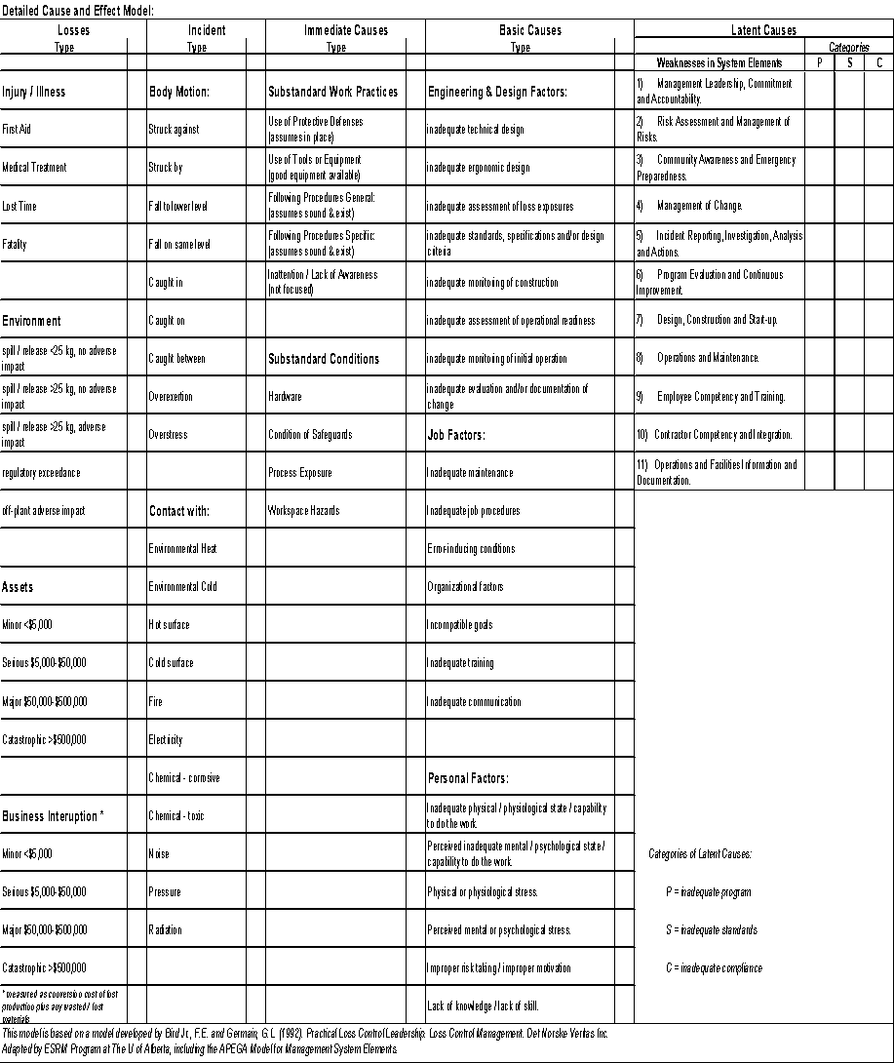
Latent Causes and the Risk Management System Elements:
Categories of Latent Causes:
P = Inadequate Program
S = Inadequate Standards
(Standard = administrative control)
C = Inadequate Compliance
Chapter 4.2: C&E Model & Chapter 4.3: RCA of an Incident
‹#›
Notes:
‹#›

Slide 14
Explanation of LC Categories and Hints on Latent Causes:
[P] Inadequate Program:
The overall RM Program (policy or high-level direction) and RMS Element that relate to that particular latent cause are non-existent for or lacking in large part.
[S] Inadequate Standards (of the program):
Program exists but supporting administrative controls are non-existent or inadequate for that particular root of analysis
The administrative controls (policies, procedures, checklists, schedules) document in detail the tasks / instructions and roles / responsibilities for undertaking activities and managing the risks of those activities.
[C] Inadequate Compliance (with program standards):
Program and supporting documentation exist, but the work practices (the actual execution of the work) do not comply with the requirements as specified in the standard i.e. not being done or not being done correctly.
HINT: Because the categories of latent causes are inadequate program, inadequate standards, and inadequate compliance, then the latent cause must be expressed in similar terms.
Chapter 4.2: C&E Model & Chapter 4.3: RCA of an Incident
‹#›
Notes:
‹#›

Slide 15
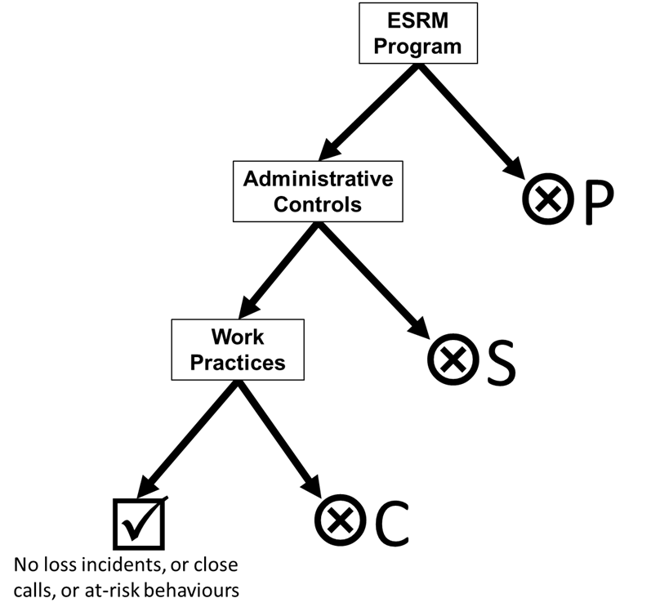
Categories for Latent Causes – P, S, and C:
Which Category – P, S, or C?
Can the P, S, or C category for a latent cause be determined in an RCA?
Yes – if you have sufficient information which
will likely be the case in the workplace when
you investigate, lead an RCA, etc.
No – in absence of information i.e. team project:
    You will not have sufficient information to
    discern P, S, or C.
    Use your engineering know-how, your
    expertise in risk management, and
    knowledge of the incident to make reasonable suppositions.
    The manner in which you state your latent cause may reveal whether it is P, S, or C.
    More than likely, in your team project, you will express the latent cause as either a “P” or an “S”.
Chapter 4.2: C&E Model & Chapter 4.3: RCA of an Incident
‹#›
Notes:
‹#›

Slide 16

Example Model for the Set of Categories of Latent Causes:
Large grey arrow is
the desired path …
but may deviate!
Chapter 4.2: C&E Model & Chapter 4.3: RCA of an Incident
‹#›
Notes:
‹#›

Slide 17
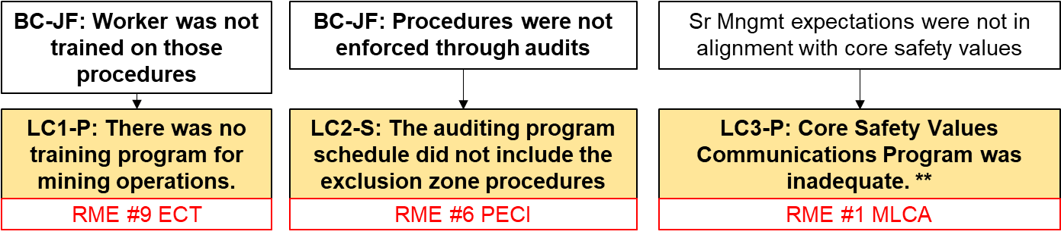
Example Model for the Set of Categories of Latent Causes:
Apply this concept to our mining case study. For the latent causes, choose the category:
P – inadequate program
S – inadequate standards
C – inadequate compliance
#1: MLCA – Core Safety Values Communications Program was inadequate.** >> P
#6: PE&CI – The auditing program schedule did not include exclusion zone procedures. >> S
#9: EC&T – There was no training program for mining operations.
>> P
Chapter 4.2: C&E Model & Chapter 4.3: RCA of an Incident
‹#›
Notes:
‹#›

Slide 18
Basic Causes
Debris fell, injuring one Worker & damaged equipment
IC-SC: Equipment & Worker Were In Exclusion Zone
The RCA Chart
is developed!
Latent Causes
IC-SP: Worker did not follow exclusion zone procedures
BC-PF: Worker was not aware of exclusion zone procedures
IC-SP: Worker disregarded exclusion zone procedures
BC-PF: Supervisor told Worker to go into the exclusion zone
BC-JF: Supervisor prioritized production over safety
Latent causes are numbered, categorized, and aligned with an RME
Supervisor believed that production was paramount over safety
BC-JF: Worker was not trained on those procedures
Procedures were not enforced through audits
Sr Mngmt expectations were not in alignment with core safety values
LC1: There was no training program for mining operations.
LC2: The auditing program schedule did not include the exclusion zone procedures
LC3: Core Safety Values Communications Program was inadequate. **
RME #9 ECT
RME #6 PECI
RME #1 MLCA
Chapter 4.2: C&E Model & Chapter 4.3: RCA of an Incident
‹#›
Notes:
‹#›

Slide 19
Examples of Latent Causes in Different Categories:
Debris fell, injuring one Worker & damaged equipment
Equipment & Worker Were In Exclusion Zone
Basic Causes
Latent Causes
Worker did not follow exclusion zone procedures
Worker was not aware of exclusion zone procedures
Revisit One Basic Cause in the
“Mine Loss RCA”
BC-JF: Worker was not trained on those procedures
LC1-P: There was no training program for mining operations.
RME #9 ECT
Chapter 4.2: C&E Model & Chapter 4.3: RCA of an Incident
‹#›
Notes:
‹#›

Slide 20
Examples of Latent Causes in Different Categories:
This example demonstrates how one basic cause “could” be caused by a weakness in the same element (latent cause), but different categories of that latent cause. Note the difference in LC1, LC4, & LC5:
LC1: “no program”; therefore “P – inadequate program”
LC4: the existence of a program is implied, but it lacks
in details; therefore “S – lack of program standards”
LC5: The program and standards are implemented, but
were not executed as required; therefore
“C – inadequate compliance with program standards”
A real investigation will only reveal one of these.
Your team project need only identify ONE, not all three.
Worker did not follow exclusion zone procedures
Worker was not aware of exclusion zone procedures
BC-JF: Worker was not trained on those procedures
LC4-S: The employee training program did not include exclusion zone procedures
LC5-C: The employee training program on exclusion zone procedures was not completed as specified.
LC1-P: There was no training program for mining operations.
RME #9 ECT
RME #9 ECT
RME #9 ECT
Chapter 4.2: C&E Model & Chapter 4.3: RCA of an Incident
‹#›
Notes:
‹#›

Slide 21
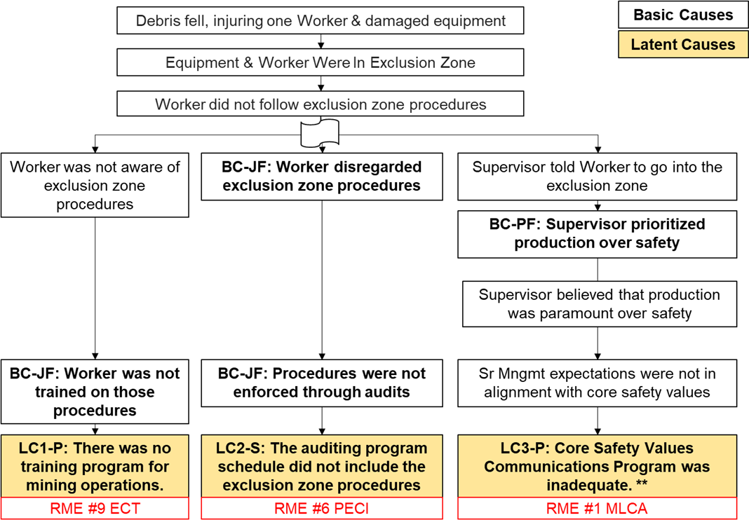
Developing an RCA: Breadth and Depth Illustrated
Breadth and Depth of the Scope of a Root Cause Analysis:
Not deep enough
Depth is right when you discover the LC
Breadth too narrow (3 LC’s)
Breadth about right (18+ LC’s)
Chapter 4.2: C&E Model & Chapter 4.3: RCA of an Incident
‹#›
Notes:
‹#›

Slide 22
Developing an RCA: Depth Illustrated
Not deep enough
Importance of Depth in a Root Cause Analysis:
Did not drill deep enough. Ask yourself these questions:
Can this cause be linked to an RME in a meaningful and obvious way?
Can a recommendation relating to an RME be made?
Can the cause be categorized as a basic cause? If so, it is NOT a latent cause!
Chapter 4.2: C&E Model & Chapter 4.3: RCA of an Incident
‹#›
Notes:
‹#›

Slide 23
Developing an RCA: Breadth Illustrated
Importance of Breadth in a Root Cause Analysis:
This RCA spanned three (3) risk management system elements.
Are these 3 LCs specific and unique? (A: YES)
Are these 3 LCs through 3 separate roots? (A: YES)
Can other LCs relating to other RMEs be found? (A: YES)
Team Project:
Preliminary RCA Chart – 3 separate roots to 3 unique LCs
Progress Report – at least 18 unique, specific LCs;
feedback provided for improvements
Final Technical Report – a completed RCA Chart with improvements!
Breadth too narrow (3 LC’s)
Chapter 4.2: C&E Model & Chapter 4.3: RCA of an Incident
‹#›
Notes:
‹#›

Slide 24
Root Cause Analysis – Down to Latent Causes:
Drill down through causal analysis to determine latent causes, and
Identify and address weaknesses in the management system elements (the latent causes); this sets the stage for recommendations!
Be able to link a latent cause to a management system element and create a recommendation
Chapter 4.2: C&E Model & Chapter 4.3: RCA of an Incident
‹#›
Notes:
‹#›

Slide 25
Practice: Apply The Narrative & How to Avoid Logic Leaps
Intermediate causes serve as links between the categories of causes in order to avoid leaps in logic!
Use the narrative technique to uncover logic leaps!
The Worker disregarded the exclusion zone procedures, because
The auditing program schedule did not
include exclusion zone procedures.
Worker disregarded exclusion zone procedures
For this narrative of a root:
“The Worker disregarded the exclusion zone procedures,“
because (or was caused by)
“The auditing program schedule did not include exclusion zone procedures”
Does this statement make sense?
What details are needed to avoid this logic leap?
LC2-S: The auditing program schedule did not include the exclusion zone procedures
RME #6 PECI
Chapter 4.2: C&E Model & Chapter 4.3: RCA of an Incident
‹#›
Notes:
‹#›

Slide 26
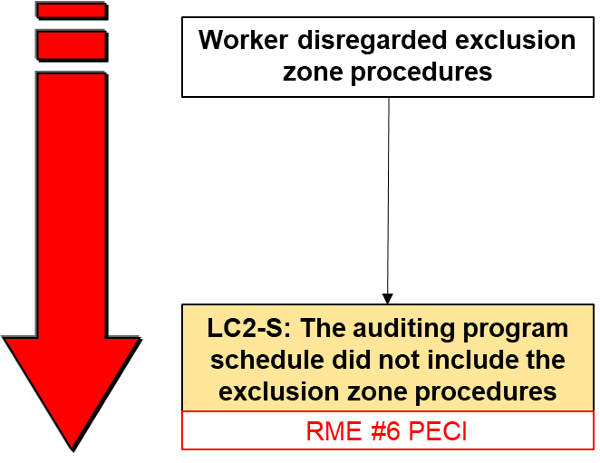
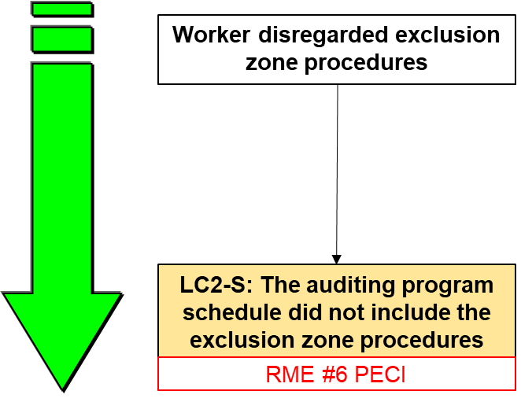
Practice: Apply The Narrative & A Latent Cause
Q: Is this narrative for a root complete, logical,
and does it make sense?
The Worker disregarded the exclusion zone
procedures, because (or was caused by)
The auditing program schedule did not
include exclusion zone procedures
A: [NO]
Q: Is this an improvement?
The Worker disregarded exclusion
zone procedures, because
procedures were not enforced
through audits, because
LC2: The auditing program
schedule did not include the
exclusion zone procedures
A: [YES]
procedures were not enforced through audits
Chapter 4.2: C&E Model & Chapter 4.3: RCA of an Incident
‹#›
Notes:
‹#›

Slide 27
Debris fell, injuring one Worker & damaged equipment
Basic Causes
Latent Causes
The RCA for the “Mine LI” is complete … or is it?
Equipment & Worker Were In Exclusion Zone
Worker did not follow exclusion zone procedures
Worker was not aware of exclusion zone procedures
Worker disregarded exclusion zone procedures
Supervisor told Worker to go into the exclusion zone
BC-PF: Supervisor prioritized production over safety
Supervisor believed that production was paramount over safety
BC-JF: Worker was not trained on those procedures
BC-JF: Procedures were not enforced through audits
Sr Mngmt expectations were not in alignment with core safety values
LC1-P: There was no training program for mining operations.
LC2-S: The auditing program schedule did not include the exclusion zone procedures
LC3-P: Core Safety Values Communications Program was inadequate. **
RME #9 ECT
RME #6 PECI
RME #1 MLCA
Chapter 4.2: C&E Model & Chapter 4.3: RCA of an Incident
‹#›
Notes:
‹#›

Slide 28
Example: Apply the Narrative & How to Avoid Logic Leaps
The “value” in doing the Root “Narrative”:
Debris fell on equipment, injuring
one Worker & damaged equipment;
Because the Equipment & Worker
Were In Exclusion Zone;
Because the Worker did not follow
exclusion zone procedures;
Because the Worker disregarded
exclusion zone procedures;
Because Procedures were not enforced
through audits;
Because Managers did not
complete audits on procedures;
Because The auditing program schedule
did not include exclusion zone procedures.
Debris fell on equipment, injuring one Worker & damaged equipment
Equipment & Worker Were In Exclusion Zone
Worker did not follow exclusion zone procedures
Worker disregarded exclusion zone procedures
Procedures were not enforced through audits
Improved!
Managers did not complete audits on procedures
LC2-S: The auditing program schedule did not include exclusion zone procedures
Chapter 4.2: C&E Model & Chapter 4.3: RCA of an Incident
‹#›
Notes:
‹#›

Slide 29
Debris fell, injuring one Worker & damaged equipment
Basic Causes
Latent Causes
Equipment & Worker Were In Exclusion Zone
Now there is very little room for improvement … “Mine LI”!
Worker did not follow exclusion zone procedures
Worker was not aware of exclusion zone procedures
Worker disregarded exclusion zone procedures
Supervisor told Worker to go into the exclusion zone
BC-PF: Supervisor prioritized production over safety
BC-JF: Procedures were not enforced through audits
Supervisor believed that production was paramount over safety
BC-JF: Worker was not trained on those procedures
Managers did not complete audits on procedures
Sr Mngmt expectations were not in alignment with core safety values
LC1-P: There was no training program for mining operations.
LC2-S: The auditing program schedule did not include the exclusion zone procedures
LC3-P: Core Safety Values Communications Program was inadequate. **
RME #9 ECT
RME #6 PECI
RME #1 MLCA
Chapter 4.2: C&E Model & Chapter 4.3: RCA of an Incident
‹#›
Notes:
‹#›

Slide 30
Best Practices: The Latent Cause Statement, page 1 of 4
Best practices for writing a latent cause statement:
Unique and specific to the root
Relates to one RM element
Expressed in terms relating to:
“P = Inadequate Program”,
“S = Inadequate Program Standards”, or
“C = Inadequate Compliance with Program Standards”
Some fairly simple forms of a statement for a latent cause in this RCA:
[Statement A is unacceptable – this “blames management”]
A: Managers did not complete audits on exclusion zone procedures.
[Statement B is acceptable, although more detail would be helpful.]
B: The auditing program schedule did not include exclusion zone procedures.
Chapter 4.2: C&E Model & Chapter 4.3: RCA of an Incident
‹#›
Notes:
‹#›

Slide 31
Best Practices: The Latent Cause Statement, page 1 of 4
Best practices for writing a latent cause statement:
Let’s look at another LC example: “The Core Safety Values Communications program was inadequate" is vague and lacks detail. More detail is needed to make it specific and unique to the root, and it helps you create a recommendation for action. In what manner is it inadequate? What do you want to "fix" on the inadequate communications program?
Possible correction:
It is debatable as to whether this is a P or an S as it depends on the contextual information of the organizations: If other standards of the MLCA program are absent, then likely a “P”; if this is the only standard missing, then “S”.
Now consider this latent cause statement!
LC3-P: Core Safety Values Communications Program was inadequate. **
** Is this an acceptable latent cause statement? We will revisit this!
LC3-S: The Leadership program did not include Core Safety Values Communications standard.
Chapter 4.2: C&E Model & Chapter 4.3: RCA of an Incident
‹#›
Notes:
‹#›

Slide 32
Best Practices: The Latent Cause Statement, page 2 of 4
Some great examples of latent cause statement (from a different LI and RCA):
LC1-P: There was no training program for any engineers that were hired by the company. #9EC&T
LC2-S: The incident reporting program was inadequate as it did not include reporting criteria (standards) for minor incidents. #5 IRIAA
LC3-S: The MOC program did not include a process or procedure (a standard) to communicate between management and training instructors about changes in training courses and requirements. #4 MOC
LC4-S: The design program did not include a standard to describe how to manage and access the most current hydraulic designs. #7 DC&SU
LC5-C: The community awareness program had standards that described the downstream risks of the dam operation but these standards were not communicated to the downstream residents. #3 CA&EP
Chapter 4.2: C&E Model & Chapter 4.3: RCA of an Incident
‹#›
Notes:
‹#›
Consider these two versions of a latent cause statement:
"LC4-S: The design program was inadequate with regards to managing and accessing the most current hydraulic standards. #7 DC&SU" is an inferior example of a latent cause statement because it is somewhat vague in terms of a category of this LC.
An improvement on that LC statement is: "LC4-S: The design program did not include a standard to describe how to manage and access the most current hydraulic standards. #7 DC&SU"

Slide 33
Best Practices: The Latent Cause Statement, page 3 of 4
What do these great examples of latent cause statement have in common?
They all have these items in common:
Labelled and numbered: LC1, LC2, etc.
Categorized as P, S, or C (The categorization with appropriately stated latent causes demonstrates the ability to differentiate among the three categories of latent causes.)
Each statement has four components, not specifically in this order:
Relates to an element “training”, “design”, “incident reporting”, etc.;
Has the word “program”;
Gives some level or degree of inadequacy that relates to the LC category e.g. inadequate program, inadequate program standards, or inadequate compliance with program standards;
Specific and unique terms or phrases relevant to the root in question.
The stated latent cause then clearly links to a Risk Management System element.
Chapter 4.2: C&E Model & Chapter 4.3: RCA of an Incident
‹#›
Notes:
‹#›

Slide 34
Best Practices: The Latent Cause Statement, page 4 of 4
Use examples to write your latent cause statements:
Look again at those examples and the specific items.
See these resources:
“Factors often missed or completed incorrectly for the RCA chart” in the Team Project Instruction Manual
Topic #18 Chapter 4.2: Cause and Effect Model for Incident Analysis and Chapter 4.3: Root Cause Analysis of an Incident - Fundamentals
Topic #19 Chapter 4.2: Cause and Effect Model for Incident Analysis and Chapter 4.3: Root Cause Analysis of an Incident - Latent Causes
Topic #34 Chapter 4.5 Linking Latent Causes to Recommendations for Action
Chapter 4.2: C&E Model & Chapter 4.3: RCA of an Incident
‹#›
Notes:
‹#›

Slide 35
Developing and Validating the Causes:
Once you think you are completed:
Look for any logic leaps or any roots that could benefit with more causation details
Take time to verify by looking for hard evidence for each and every one of your causes.
Note: For your team project, plausible suppositions are acceptable!
Review the evidence and confirm your conclusions with your workplace colleagues. (Team project: check your suppositions with your team-mates; are they plausible?)
This activity validates the actual causes (or plausible causes in the case of your Team Project Loss Incident) and will be very supportive and valuable for determining recommendations and action items.
Chapter 4.2: C&E Model & Chapter 4.3: RCA of an Incident
‹#›
Notes:
‹#›

Slide 36
Key Lessons:
It is really, really easy to do a root cause analysis … badly.
It takes practice to do a root cause analysis well!
Incidents have causes rooted in management system weaknesses;
these are called latent causes (also sometimes called root causes).
Latent causes can be discovered through a rigourous and disciplined root cause analysis; thus, management can take action on the management system to address the latent causes.
A Latent Cause is synonymous with a weakness a management system element, and can be aligned to any one specific management system element; thus, one can begin to make a recommendation to correct the weakness in the management system, and eliminate the latent cause that lead to incidents.
Chapter 4.2: C&E Model & Chapter 4.3: RCA of an Incident
‹#›
Notes:
‹#›

Slide 37
Key Lessons:
Must relate the basic causes to the latent causes.
Requires a bit of reverse logic. A trick to use when you are at that level of the analysis:
express each weakness in a RMS element as a failure,
then compare each of these failures with the basic causes.
Each latent cause has a direct link to one, unique management system element that failed.
There is no universal set of latent causes; these must be expressed as weaknesses in the management system elements for the organization.
A well-written, acceptable latent cause statement enables the creation of a recommendation to address that latent cause.
For reporting all causes types, not so important to align causes with the detailed lists; it is important to recognize cause type and in which major group a cause sits.
Chapter 4.2: C&E Model & Chapter 4.3: RCA of an Incident
‹#›
Notes:
‹#›

Slide 38
Summary:
Categories and sub-categories of causes:
Immediate Causes
Basic Causes
Latent Causes
The RCA Work Process is used to create a logical sequence and understanding of incident causation in an RCA Chart.
The Cause and Effect Model is used to categorize causes and to test the depth and breadth of a Root Cause Analysis.
Note on loss incident team project, you will use the available facts AND your engineering know-how and deduction skills to analyze the potential sequences that can lead to the incident in a similar context; apply your skills of rationale and supposition to determine possible, probable, plausible, and conceivable causes.
Chapter 4.2: C&E Model & Chapter 4.3: RCA of an Incident
‹#›
Notes:
‹#›

